Slide 1
Flag Football Official Rules

Slide 2
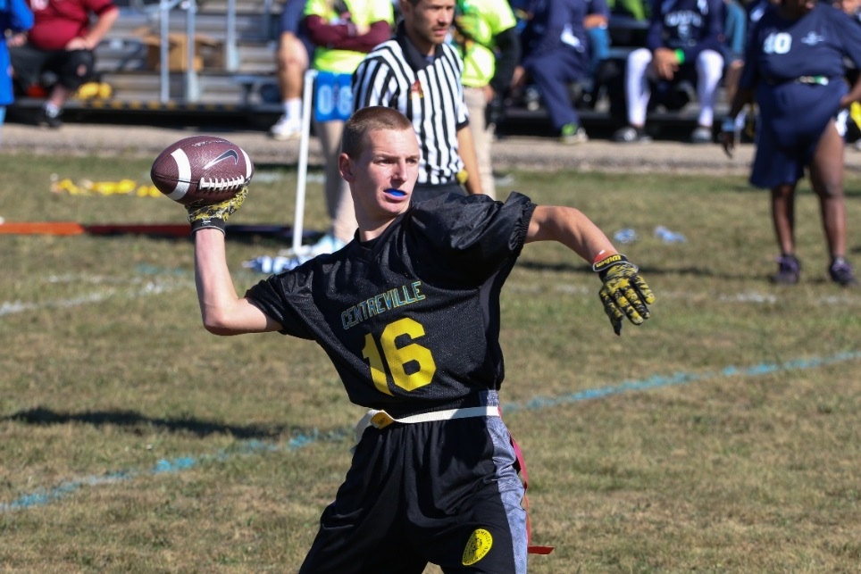
A picture paints a thousand words
“Let me win, but if I cannot win, let me be brave in the attempt.”
“Let me win, but if I cannot win, let me be brave in the attempt.”
Use the Picture and Caption format to create strong compelling slide like this. Don’t’t forget to caption where possible. For best effect crop the image to fill the placeholder.

Slide 3
The Basics
Sport season:
June-September
Culminating State Events:
State Fall Games

Slide 4
Events Offered
Individual Skills Competitions
Traditional Team
Unified Team

Slide 5
Uniform Guidelines and Equipment
Uniforms consist of a jersey, shorts, and sport shoes. All team members must have identical uniforms in color and design. The Special Olympics Michigan logo must be on the jersey
Athletes may wear rubber-cleated or flat soled athletic shoes.
Team jerseys must be the same solid color front and back and must be tucked in at the waits. Jerseys may not hang over flag belts. Numbers must appear on the front and the back of each athlete's jersey. A team roster shall not have both numbers 0 and 00. All players must wear athletic shorts without pockets.

Slide 6
Uniform Guideline and Equipment Cont.
Hats, bandanas, du-rags, jewelry, and denim may not be worn during games or practice. Headbands, wristbands, and arm sleeves are acceptable. Headwear for religious or medical reasons are acceptable but must be brought to the attention of the Games Director prior to competition. Jewelry is not allowed.
All players must have a mouthpiece to be used during competition at all times.

Slide 7
Uniform Guideline and Equipment Cont.
An intermediate (youth) sized football will be used in all divisions. Each athlete will wear a one piece, three-flag belt during competition. The flags should be located one on each hip and one on the backside.
A special marker will be placed five yards from the line of scrimmage to mark the spot the defensive player rushing the quarterback must start behind.

Slide 8
Course Layout

Slide 9
Playing Field
The playing field is 60 yards long (including the end zones) and 25 yards wide. If insufficient space is available, a slightly smaller space can be used. A space of at least 5 yards around the field must be free and clear of obstructions.
No-Run Zones are in place to prevent teams from conducting power run plays. While in the No-Run Zones (a 5-yard imaginary zone before midfield and before the end zone), teams cannot run the ball in any fashion. All plays must be pass plays, even with a handoff.

Slide 10
Playing Field Cont.
Each offensive team approaches only TWO (2) No-Run Zones in each drive (a 5-yard zone before midfield to gain the first down and before the end zone, 5 yards from the goal line to score a TD).

Slide 11
General Rules

Slide 12
General Rules
Special Olympics Flag Football is non-contact. In all aspects of Special Olympics Flag Football, rulings shall be made with player safety as the primary consideration.
Neither team shall commit any act which, in the opinion of the referee, tends to make a travesty of the game. This includes intentionally committing penalties to gain an advantage. The referee will enforce any penalty he/she considers equitable, including the award of a score for an unfair act.

Slide 13
Possessions
All possessions, except following an interception, start at the offensive team’s 5- yard line.
The offense has four (4) plays to cross mid-field, once the offense crosses mid-field, they have four (4) additional plays to score a touchdown. If the offensive team fails to cross mid-field or score a touchdown in a prescribed number of plays, possession of the ball changes and the opposite team starts at their 5-yard line.
The ball is marked at the spot where the position of the ball is when the player is declared down (carrier’s flag belt is pulled or hand/knee touches ground).

Slide 14
Timing
The game shall consist of two (2) 20-minute halves with a running game clock
The clock will stop on all time-outs; each team receives one (1) 60-second time-out per half, an unused time-out in the first half does not carry over to the second half.
The ball must be put in play within 30 seconds of the previous play ending, any action or lack of action by either team that tends to prevent this is considered a delay of game.

Slide 15
Delay of Game- Includes:
Interrupting the 30-second count for any reason except for a granted time-out,
Consuming more than 30-seconds to snap the ball after it is ready for play
Failing to remove an injured player for whose benefit an excess time-out has been granted,
Deliberately advancing the ball after it has been declared dead.

Slide 16
Overtime
A coin toss is held to determine the first possession
Each team receives two (2) plays from midfield and the team gaining the most points or gaining a yardage advantage is awarded one (1) extra point and wins the game.
Exceptions to this rule: 1) If there is an interception; the team that intercepts the pass automatically wins the game. 2) If the team with the first attempt in overtime scores on the first play, the opposing team must score on its first play also.
If both teams score a touchdown, or gain the same yardage, the procedure is repeated until one (1) team wins.

Slide 17
Scoring
Touchdown: six (6) points.
Extra Point: one (1) point from the 5-yard line, two (2) points from the 12-yard line (or any distance outside 5 yards due to a penalty).
Safety: two (2) points.

Slide 18
Positions/Snap
The ball must be snapped between the Center’s legs to start each play. No minimum number of players is required to line-up on the line of scrimmage.

Slide 19
Dead Ball/Fumbles
The ball carrier’s flag is pulled
The ball carrier loses his/her flag
The ball carrier steps out of bounds
The ball carrier’s knee or hand touches the ground
A touchdown, extra point, or safety is scored
When during a try-for-point the defense obtains possession of the ball
When a forward pass strikes the ground or is caught simultaneously by opposing players
A pass is intercepted
A receiver catches a ball without his/her flags attached
A snapped ball touches the ground
If fumbled forward, the ball is spotted where the ball carrier’s feet were at the time of the fumble. If ball falls backwards, it is marked where it hits the ground
When there is an inadvertent whistle.

Slide 20
Running
The Quarterback (first player gaining possession of the snap) cannot advance the ball across the line of scrimmage.
Only direct hand-offs behind the line of scrimmage are legal.
In Unified Sports® divisions, a partner may handoff to a partner behind the line of scrimmage.
The player who takes a hand-off can pass the ball, as long as he/she does not pass the line of scrimmage.

Slide 21
Running Cont.
3. No Running Zones” are located 5-yards before the mid-field line and goal line. Any ball snapped from these zones must be passed.

Slide 22
Event Modifications

Slide 23
Unified Flag Football Rules
The roster shall contain an equal number of traditional athletes and unified partners, equal means at least 3 traditional athletes and 3 unified partners.
Unified Partners as quarterbacks may not pass to another Unified Partner
Unified Partners may not hand-off to another Unified Partner.

Slide 24
Individual Skills Contest

Slide 25
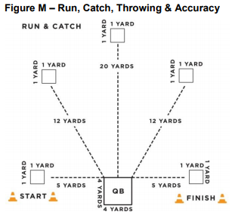
Run and Catch
Purpose: To measure athlete’s ability to catch a football.
Scoring
2 pts: for a complete catch
0 pts: if athlete is unable to catch or touch a well-thrown pass
Athletes can gain a maximum of 10 points in this drill

Slide 26
Throwing for Accuracy
Purpose: To measure the athlete’s ability to throw a football accurately.
The quarterback box should be placed in between the starting and finish line.
The quarterback box will be 4 yards X 4 yards.
Catching spots are 1 yard X 1 yard.
Catching Boxes 1 & 5 will be 5 yard from the quarterback box.
Catching Boxes 2 & 4 will be 12 yards from the quarterback box.
Catching Box 3 will be 20 yards from the quarterback box.

Slide 27
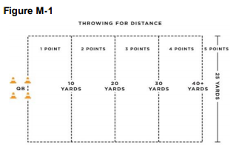
Throwing for Distance
Purpose: To measure the athlete’s ability to throw a football for distance.
Description: Athlete gets two attempts to throw football as far as possible. The goal line of a Special Olympics flag football field can be used as the starting line

Slide 28
Agility and Speed: Hand-Off
Purpose: To measure the athlete’s speed, agility and ability to receive a hand-off.
Description
The quarterback will give the signal and hand the ball off to the athlete
The athlete must maneuver around the four cones and sprints to the finish line/end zone between the cones and must maintain possession of the football.
If an athlete losses control of the ball, the clock continues to run. The athlete can recover the ball. However, if the ball goes outside the 3m lane, the athlete can either pick up the nearest back-up football or recover the errant football to continue the event.

Slide 29
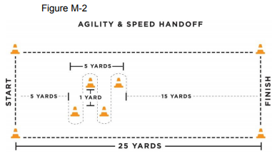
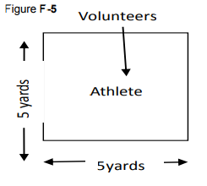
Agility and Speed: Hand-Off Cont.

Slide 30
Thank you!

